Slide 1
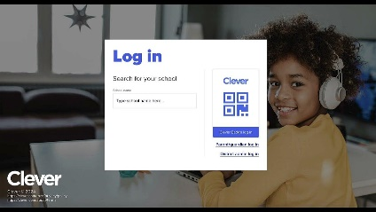
LEARNING PATH
LEVEL LEARNING
SPANISH
STEPS
Access Clever
Open a web browser (Chrome).
Type “Clever” in the search bar and press Enter.
Click on the Clever link.
2. Log in to Clever
Click the “Log in” button.
Log in with your school account (email and password).
3. Select level learning
Once inside Clever, find and click on the Level Learning icon.
.
4. Explore the platform
You can choose from:
✅ Read a story: Explore books in Spanish.
✅ Practice phonics: Reinforce sounds and pronunciation

Slide 2
LEARNING PATH
EDMENTUN
MATH AND READING
STEPS
Access Clever
Open a web browser (Chrome).
Type “Clever” in the search bar and press Enter.
Click on the Clever link.
2. Log in to Clever
Click the “Log in” button.
Log in with your school account (email and password).
3. Select Edmentun
Once inside Clever, find and click on the Edmentun icon.
.
4. Explore the platform
You can choose from:
✅ Math: Math activities and exercises.
✅ Reading: Reading and comprehension practices.

